Slide 1
SEBA
11/13/13

Slide 2
Philippines typhoon
Estimated $12 - $15 billion in loses. About 5% of economic output.
UN and Red Cross coming in to help
Water and wind still bad so limiting amount of help that can arrive
4/5 airports have reopened
Damage is predicted to have 10% impact through next year.

Slide 3
Stimulus Outlook
Fed next meets on Dec 17-18
Eventually has to start tapering bond buying
But many still believe will push back the decision to March
When ever it starts people are uncertain about how the market will react

Slide 4
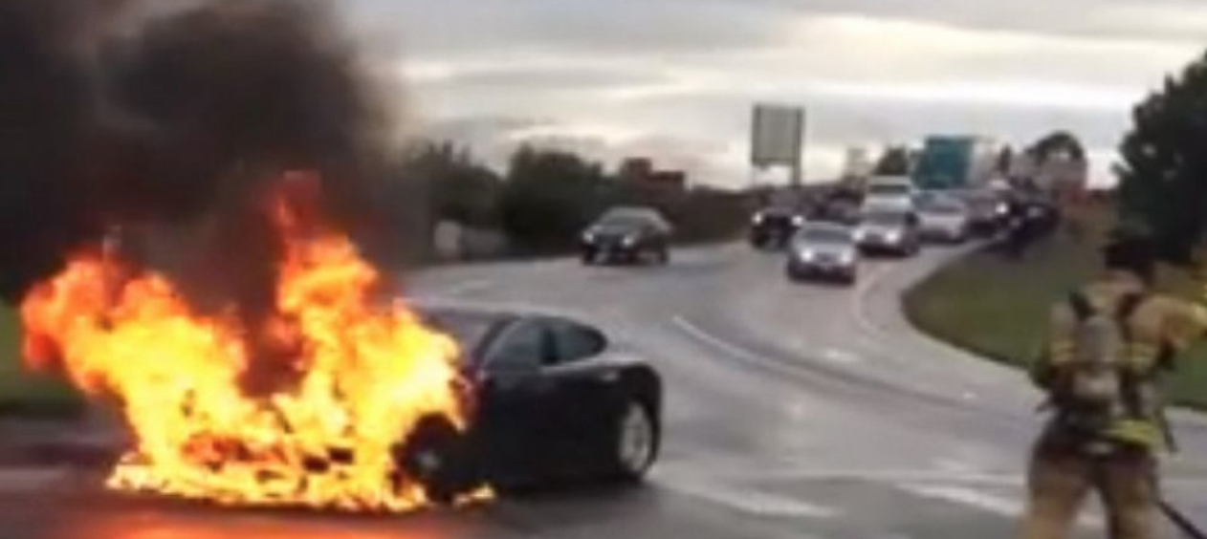
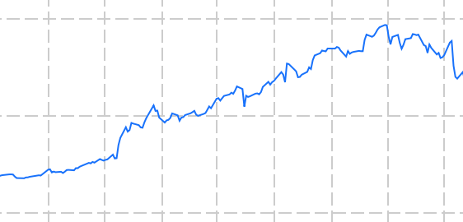
Tesla
Three cars in six weeks have caught on fire starting government investigation
Tesla is a small company, only 19,000 cars on the roads
Can they withstand bad new like this?

